Slide 1
6COSC020W: APPLIED AI
WEEK 8: Neural Networks (NNs)
Can you recognise the music playing?
Dr. Ester Bonmati
(e.bonmaticoll@westminster.ac.uk)
While you wait: pollev.com/esterbonmati
What is a neural network?
Notes:
https://soundcloud.com/openai_audio/popular-tracks

Slide 2
Before we start…
1
2
3
Poll everywhere
Pen and paper
Engage
Polls at pollev.com/esterbonmati. Answers appear only after you vote.
Some questions need a calculation. Use a notebook or your phone’s notes.
Participate in the lecture by responding to questions, asking questions …

Slide 3
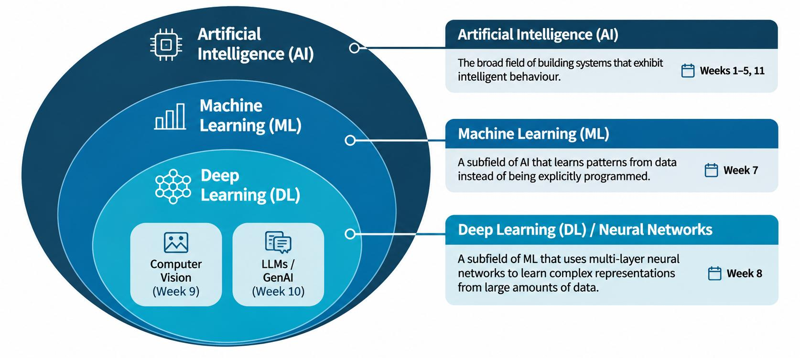
Today: Neural Networks

Slide 4
Learning outcomes
Calculate the output of a perceptron: weighted sum, bias, activation
Understand loss, gradients and backpropagation.
1
4
Explain how a perceptron learns from its mistakes
Diagnose overfitting and a bad learning rate from learning curves
2
5
Explain why one neuron is not enough, and what hidden layers add
Evaluate a model: validation, hyperparameters, accuracy and class imbalance
3
6

Slide 5

Poll Everywhere free text poll activity
Activity Title: Before: what is an artificial neural network?
Slide 5
Notes:
Do not modify the notes in this section to avoid tampering with the Poll Everywhere activity.
More info at polleverywhere.com/support
Before: what is an artificial neural network?
https://www.polleverywhere.com/free_text_polls/ec2PwmqX3TCybqK7OmrWz

Slide 6
Can we teach a computer to recognise spam?
A
Subject: You have WON!!!
Dear winner, claim your FREE holiday today. FREE flights, FREE hotel.
Click here: bit.ly/win-now
B
Subject: Assignment 2 feedback
Hi Sam, your feedback is ready: moodle.example.ac.uk/feedback
See you on Thursday. Dr Lee
Which of these two emails is spam? Why?

Slide 7
From cues to numbers
Email | Exclamation marks (x₁) | Links (x₂) | "free" count (x₃)
A | 3 | 1 | 3
B | 0 | 1 | 0
A → (3, 1, 3)
B → (0, 1, 0)
Each email becomes a list of numbers. What else would you measure?

Slide 8
Nobody writes the rules
Write the rules yourself
Learn them from examples
if exclamation marks > 2:
spam
if "free" in text:
spam
…and a new rule for every trick
Labelled emails (spam / not spam) go in. A model with adjustable numbers comes out. Training finds the numbers.
How can a computer learn to make decisions when nobody explicitly tells it the rules?
Neurons

Slide 9
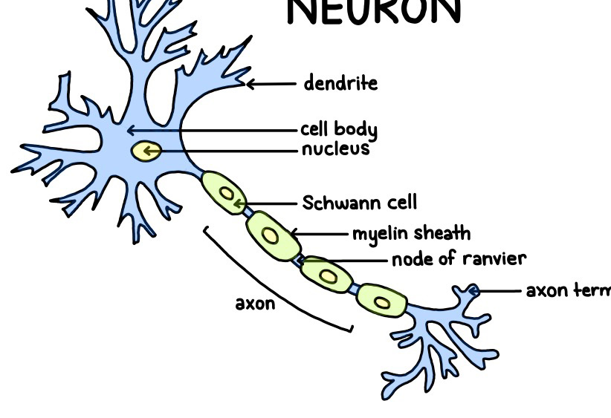
Neuron
Inputs
Output
The human brain has roughly 86 billion neurons

Slide 10

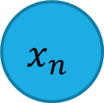

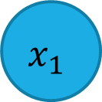
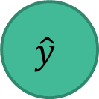



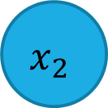

Perceptron
To learn more complex relationships
Inputs
$$bias$$
$$x_{1}$$
$$w_{1}$$
$$w_{bias}$$
$$x_{2}$$
$$w_{2}$$
$$∑$$
ƒ
$$\hat{y}$$
Output
$$w_{n}$$
$$x_{n}$$
Activation function
Weights
Sum

Slide 11


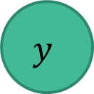
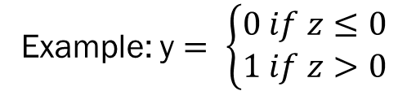

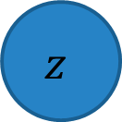
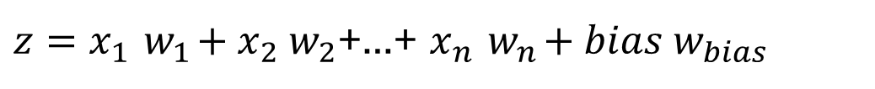
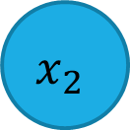


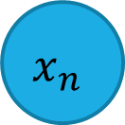

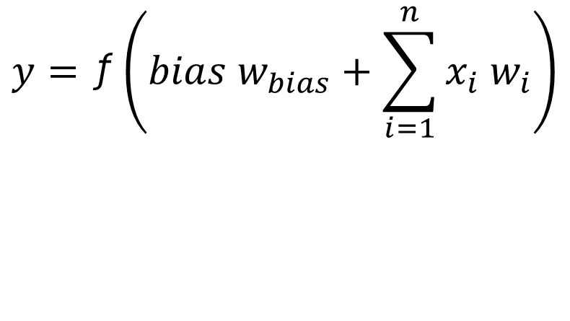
The perceptron
Building block of neural networks (single neuron)
Mimics the neuron in the human brain
Forward propagation (input → neuron → output)
Bias
Inputs
Output
$$y=\text{ƒ}\left({bias w}_{bias}+\sum_{i=1}^{n}{x_{i}{ w}_{i}}\right)$$
$$bias$$
$$x_{1}$$
Activation function
Weights
$$w_{1}$$
$$w_{bias}$$
Sum
$$x_{2}$$
$$w_{2}$$
$$z$$
ƒ
$$y$$
${z=x}_{1}{ w}_{1}+x_{2}{ w}_{2}$+…+ $x_{n}{ w}_{n}+bias{ w}_{bias}$
$$w_{n}$$
$$y=\text{ƒ}\text{(z)}$$
$$x_{n}$$
Example: y $= \left\{\begin{matrix}0 if z≤0 \\ 1 if z>0\end{matrix}\right.$
Activation function
Inputs
Weights
Sum
Output

Slide 12
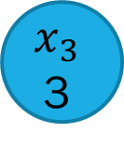
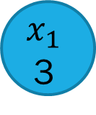
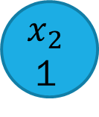

A perceptron turns features into a decision
Inputs
$$x_{1}$$
3
Exclamation marks
$$w_{1}$$
$$x_{2}$$
1
$$w_{2}$$
$$∑$$
ƒ
$$\hat{y}$$
Links
Output
$$w_{3}$$
$$x_{3}$$
3
“Free”
Activation function
Weights
Sum
Question: How much should each input matter?

Slide 13


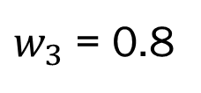
A perceptron turns features into a decision
Inputs
$$x_{1}$$
3
$$w_{1}=−0.1$$
Exclamation marks
$$x_{2}$$
1
$$w_{2}=0.2$$
$$∑$$
ƒ
$$\hat{y}$$
Links
Output
$$x_{3}$$
3
“Free”
$w_{3}$ = 0.8
Activation function
Weights
Sum
Weights say how much each input matters. Random initially (not trained).

Slide 14




A perceptron turns features into a decision
$bias$
Inputs
$$b=0.6$$
$$x_{1}$$
3
$$w_{1}=−0.1$$
Exclamation marks
$$x_{2}$$
1
$$w_{2}=0.2$$
$$∑$$
ƒ
?
Links
Spam / no spam
$$z$$
$$f(z)$$
$$x_{3}$$
3
“Free”
$w_{3}$ = 0.8
Activation function
Weights
Sum
Bias shifts the threshold. The activation function turns z into a ‘yes’ or ‘no’

Slide 15
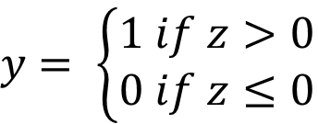
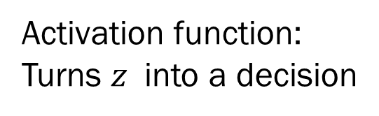

Forward propagation
$${z= x}_{1}w_{1}+x_{2}w_{2}+x_{3}w_{3}+b$$
$$y=f(z)$$
Activation function:
Turns $z$ into a decision
$y$ $= \left\{\begin{matrix}1 if z>0 \\ 0 if z≤0\end{matrix}\right.$

Slide 16
The activation: z becomes a decision
y
y = 1 if z > 0 (spam)
y = 0 otherwise (no spam)
1
spam (1)
not spam (0)
0
-3
-2
-1
0
1
2
3
z

Slide 17
How good is our ‘random’ perceptron?

Slide 18
Our data
A
Subject: You have WON!!!
Dear winner, claim your FREE holiday today. FREE flights, FREE hotel.
Click here: bit.ly/win-now
B
Subject: Assignment 2 feedback
Hi Sam, your feedback is ready: moodle.example.ac.uk/feedback
See you on Thursday. Dr Lee
Email | Exclamation marks (x₁) | Links (x₂) | "free" count (x₃) | Label
A | 3 | 1 | 3 | Spam
B | 0 | 1 | 0 | Not spam

Slide 19
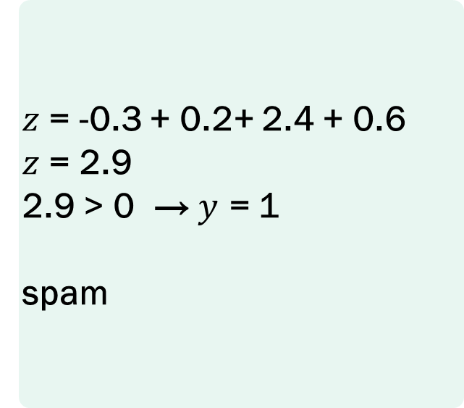
Worked example: Email A
Feature | Value x | Weight w | x × w
Exclamation marks | 3 | −0.1 | −0.3
Links | 1 | 0.2 | 0.2
"free" count | 3 | 0.8 | 2.4
Bias | 1 | 0.6 | 0.6
$z$ = -0.3 + 0.2+ 2.4 + 0.6
$z$ = 2.9
2.9 > 0 → $y$ = 1
spam
y = 1 if z > 0 (spam)
y = 0 otherwise (no spam)

Slide 20
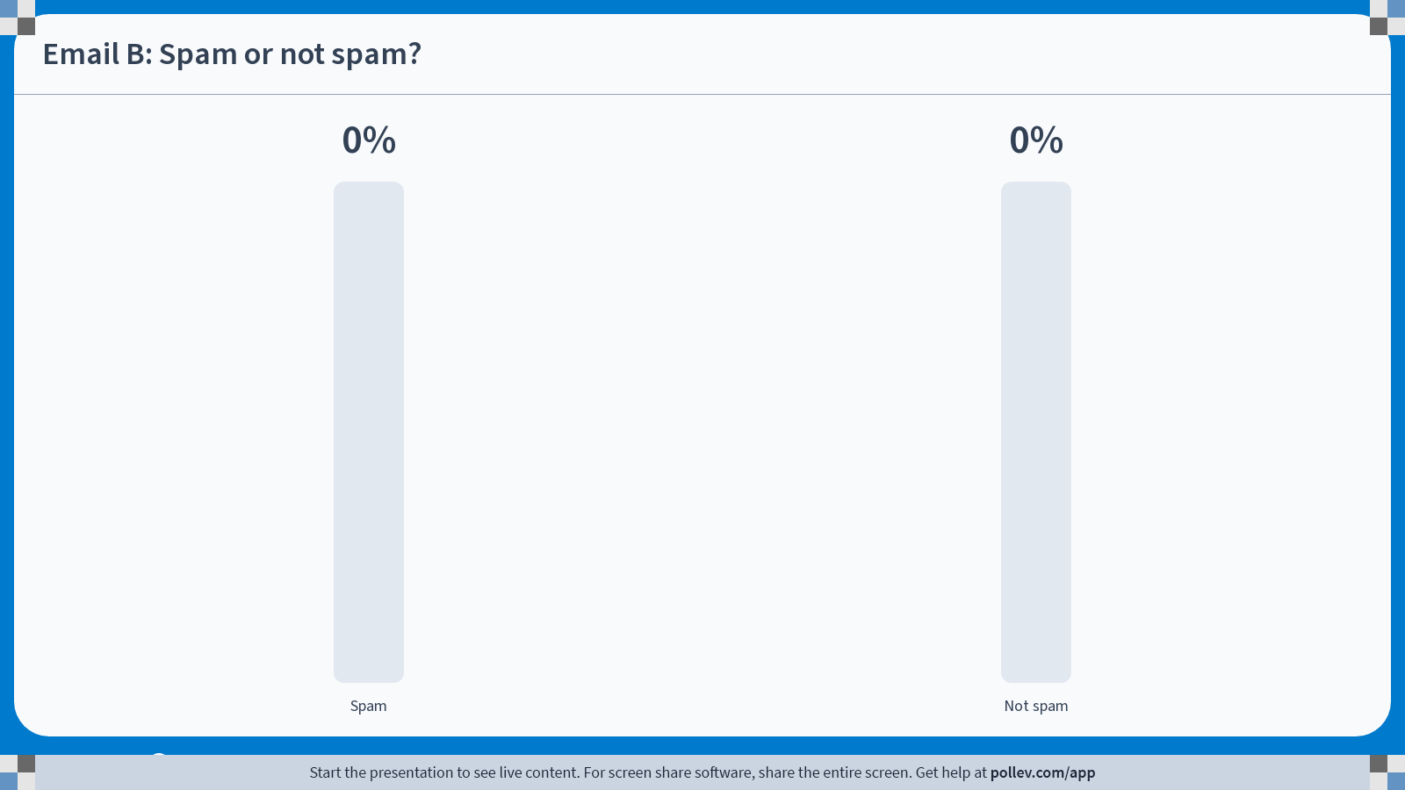
Your turn: Email B
Feature | Value x | Weight w | x × w
Exclamation marks | 0 | −0.1 | ?
Links | 1 | 0.2 | ?
"free" count | 0 | 0.8 | ?
Bias | 1 | 0.6 | ?
Calculate z
Calculate y
y = 1 if z > 0 (spam)
y = 0 otherwise (no spam)
Spam or not spam?
Compare answers with the person sitting next to you

Slide 21
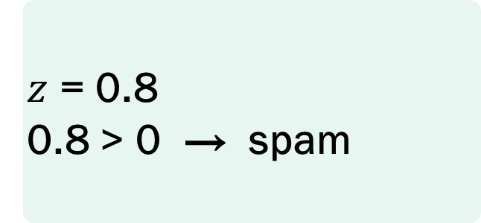
Your turn: Email B
Feature | Value x | Weight w | x × w
Exclamation marks | 0 | −0.1 | 0
Links | 1 | 0.2 | 0.2
"free" count | 0 | 0.8 | 0
Bias | 1 | 0.6 | 0.6
$z$ = 0.8
0.8 > 0 → spam
But B is not spam. The perceptron is wrong.
What can we do to make our perceptron better (more accurate)?
Update weights or bias

Slide 22
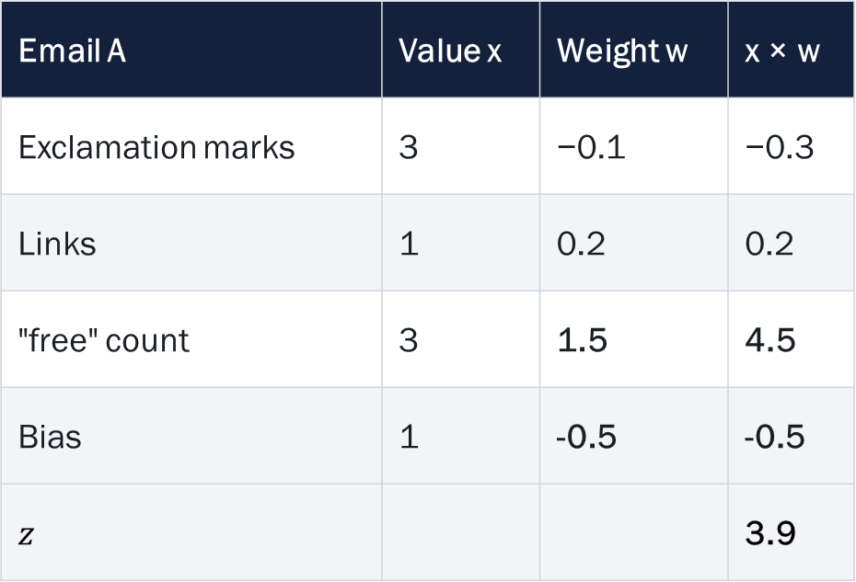
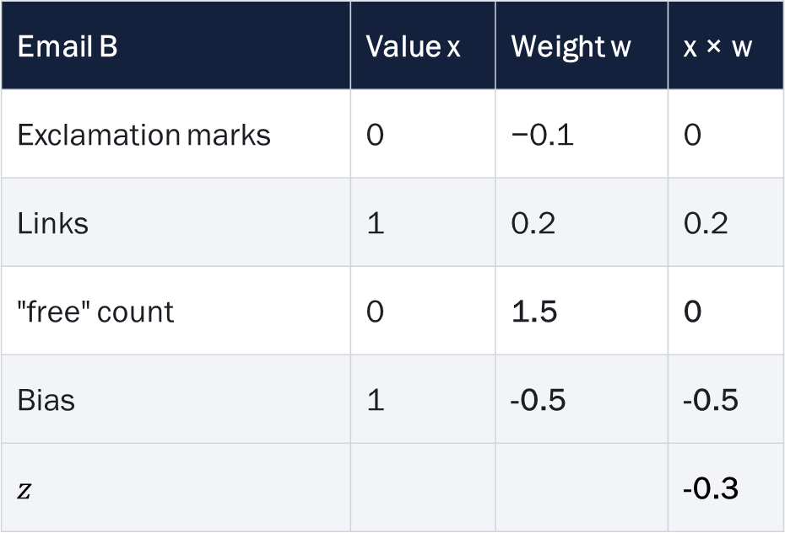
What happens if we update the weights?
We change the weight $w_{3}$ from 0.8 to 1.5 and lower the bias to -0.5. What is the result now?
Email A | Value x | Weight w | x × w
Exclamation marks | 3 | −0.1 | −0.3
Links | 1 | 0.2 | 0.2
"free" count | 3 | 1.5 | 4.5
Bias | 1 | -0.5 | -0.5
$$z$$ |  |  | 3.9
Email B | Value x | Weight w | x × w
Exclamation marks | 0 | −0.1 | 0
Links | 1 | 0.2 | 0.2
"free" count | 0 | 1.5 | 0
Bias | 1 | -0.5 | -0.5
$$z$$ |  |  | -0.3
Spam
No Spam

Slide 23
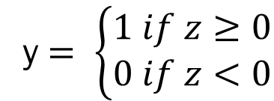





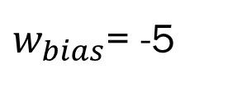


Perceptron: Another example
$$1$$
Hours of study/week
$$x_{1}$$
$$w_{1}=0.6$$
$w_{bias}$= -5
$$w_{2}=0.04$$
$$z$$
y $= \left\{\begin{matrix}1 if z≥0 \\ 0 if z<0\end{matrix}\right.$
PASS
$$x_{2}$$
FAIL
Attendance
$${z= x}_{1}w_{1}+x_{2}w_{2}+1{ w}_{bias}$$
Hours Studied (x₁) | Attendance (x₂) | Weighted Sum | Output | Prediction
2 | 50 | 0.6x2 + 0.04x50 - 5 = -1.8 | 0 | Fail
8 | 90 | 0.6x8 + 0.04x90 - 5 = 3.4 | 1 | Pass
3 | 70 | 0.6x3 + 0.04x70 - 5 = -0.4 | 0 | Fail
6 | 95 | 0.6x6 + 0.04x95 - 5 = 2.4 | 1 | Pass

Slide 24
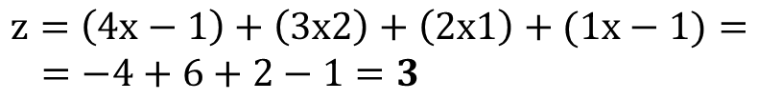




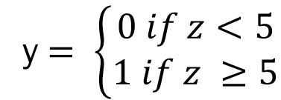
More practice: what is the output?
bias
$$1$$
y $= \left\{\begin{matrix}0 if z<5 \\ 1 if z ≥5\end{matrix}\right.$
4
-1
-1
$$z$$
$$3$$
$$3<5;y=0$$
2
3
1
$$z=\left(4x−1\right)+\left(3x2\right)+\left(2x1\right)+(1x−1)=$$
$=−4+6+2−1=3$
2
Submit your answer here: pollev.com/esterbonmati
Compare answers with the person sitting next to you

Slide 25
More data comes in….

Slide 26
The training set
Each email is a point
Two features, two classes. A perceptron draws one straight line.
feature 2
6
5
Can one straight line separate the filled points from the hollow ones?
4
3
2
1
0
1
2
3
4
5
6
spam (1)
not spam (0)
feature 1

Slide 27
Random weights: how many are right?
feature 2
w₁ = 0.75 w₂ = −0.5 b = 1
line: 0.75x₁ − 0.5x₂ + 1 = 0
6
Our perceptron
Not spam
5
4
How many of the 12 points are classified correctly?
Spam
3
Which way should we move the line?
2
1
0
1
2
3
4
5
6
spam (1)
not spam (0)
feature 1

Slide 28
When we have more data, manually changing the weights is no longer feasible.
How can we update the weights automatically to ‘learn’ to classify emails?

Slide 29
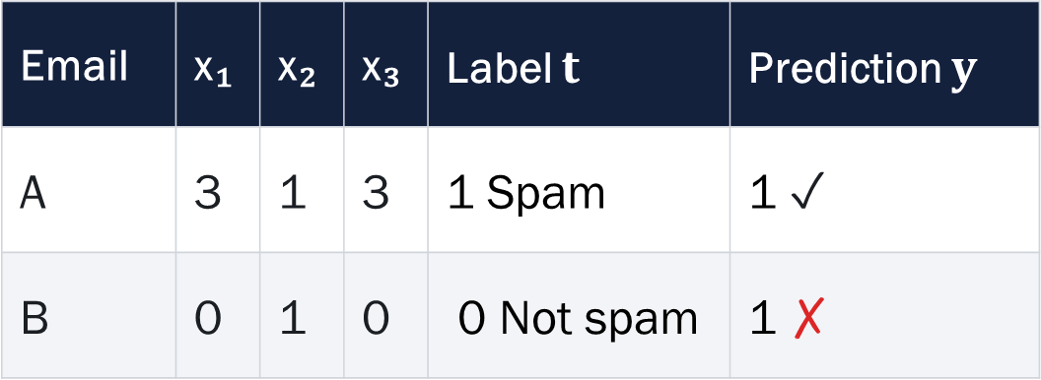
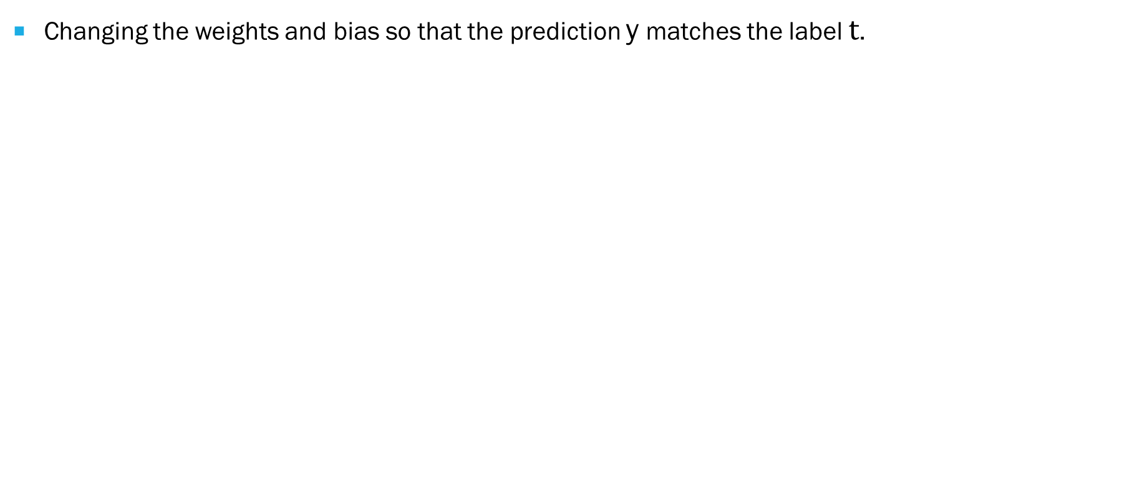
What is learning?
Changing the weights and bias so that the prediction y matches the label $t$.
Email | x₁ | x₂ | x₃ | Label $t$ | Prediction $y$
A | 3 | 1 | 3 | 1 Spam | 1 ✓
B | 0 | 1 | 0 | 0 Not spam | 1 ✗
Training data (sample)
When y ≠ t, we have an error
When the neuron makes a mistake, each weight is updated by the learning rate times the error times its input.
Parameter that controls how much the weights change during training

Slide 30
The perceptron learning rule: move z in the right direction
new_w ← w + η (t − y) x
η = learning rate
new_b ← b + η (t − y)
If the neuron predicts spam (y = 1) but the label is not spam (t = 0), then t − y = −1: we want z to go DOWN, so we subtract the input from the weights.
If it predicts not-spam but the label is spam, then t − y = +1: add the input.
If it is right, t − y = 0 and nothing changes.

Slide 31
Fix Email B with the rule
 | w₁ | w₂ | w₃ | b | z for B | B is…
start | −0.1 | 0.2 | 0.8 | 0.6 | 0.8 | spam ✗
update 1 | −0.1 | −0.05 | 0.8 | 0.35 | 0.30 | spam ✗
update 2 | −0.1 | −0.30 | 0.8 | 0.10 | −0.20 | not spam ✓
Email B: x = (0, 1, 0), label t = 0 (not spam). η = 0.25. w ← w + η (t − y) x, b ← b + η (t − y)
Email A (spam): z = 1.9, still spam ✓
Email D (spam; 1 !, 2 links, no "free"): z 0.9 → −0.6, now missed ✗
One fix can break another. Hence: loop over many examples.
Keep going until nothing is wrong. Iterate through the whole dataset.

Slide 32
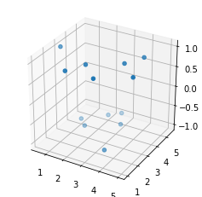



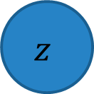
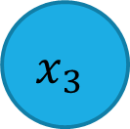








Neural networks: another example
Bias
$$bias$$
Bias
$$y= x_{1}w_{1}+x_{2}w_{2}+x_{3}w_{3}+b$$
$$x_{1}$$
$$w_{bias}$$
$$w_{1}$$
$$w_{2}$$
$$y_{1}=\text{ƒ}\text{(z)}$$
$$x_{2}$$
$$z$$
$$y_{1}$$
$$w_{3}$$
$$x_{3}$$
${z= x}_{1}w_{1}$ + $x_{2}w_{2}+x_{3}w_{3}+bias{ w}_{bias}$
[For reference only] Equation of a plane = $ax+by+cz+d$

Slide 33
Limits of a single-layer perceptron
A perceptron can solve linearly separable problems
It can only model linear decision boundaries.
Can only draw a single line (2 input features), a plane (3 input features), or a hyperplane (3+ input features).
Fails for:
  XOR
  Circular or spiral patterns
  Any data requiring a curved or disjoint boundary

Slide 34
The XOR challenge
x₂
Can one straight line separate filled from open?
1
Answer: No, a simple single neuron cannot compute XOR.
Can two straight lines separate them?
0
x₁, x₂ | OR | AND | Output
0, 0 | 0 | 0 | 0
0, 1 | 1 | 0 | 1
1, 0 | 1 | 0 | 1
1, 1 | 1 | 1 | 0
○ output 0 ● output 1
0
1
x₁

Slide 35





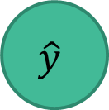
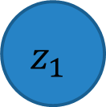

Our perceptron (1 neuron)
$$bias$$
Output
Inputs
$$w_{bias_1}$$
$$x_{1}$$
$$w_{1_1}$$
$$z_{1}$$
ƒ
$$\hat{y}$$
$$w_{2_1}$$
$$x_{2}$$
One neuron draws one line.
How do we draw two lines?

Slide 36





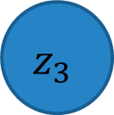



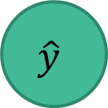
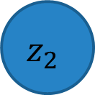


Adding a hidden layer
Hidden layer
$$bias$$
$$bias$$
Output
Output Layer
Inputs
$$w_{bias_3}$$
$$w_{bias_1}$$
$$w_{1_3}$$
$$x_{1}$$
$$w_{1_1}$$
$$z_{1}$$
ƒ
$$\hat{y}$$
$$z_{3}$$
ƒ
$$\hat{y}$$
$$w_{1_2}$$
$$w_{2_1}$$
$$z_{2}$$
$$w_{2_3}$$
$$x_{2}$$
ƒ
$$w_{2_2}$$
$$w_{bias_2}$$
$$bias$$
z = weighted sum
f = activation
ŷ = f(z₃)

Slide 37


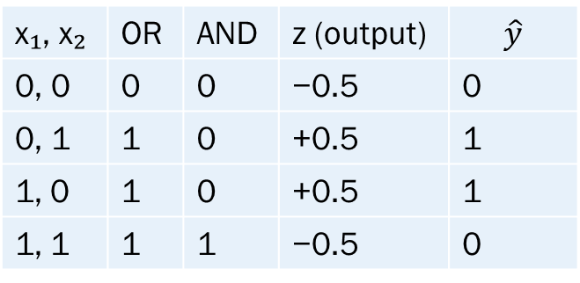




Can we compute XOR?
Yes, we can!
Hidden layer
Output Layer
Inputs
$$bias=−0.5$$
$$bias=−0.5$$
1
1
$$x_{1}$$
OR
ƒ
XOR
ƒ
$$\hat{y}$$
$$1$$
$$1$$
$$x_{2}$$
AND
ƒ
-1
$$1$$
x₁, x₂ | OR | AND | z (output) | $$\hat{y}$$
0, 0 | 0 | 0 | −0.5 | 0
0, 1 | 1 | 0 | +0.5 | 1
1, 0 | 1 | 0 | +0.5 | 1
1, 1 | 1 | 1 | −0.5 | 0
$$bias=−1.5$$
Activation function:
f(z) = 1 if z > 0, otherwise 0

Slide 38
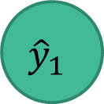
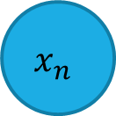
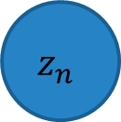

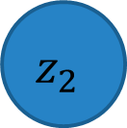


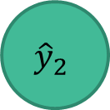
From perceptron to multi-layer neural networks
$$x_{1}$$
$$z_{1}$$
$${\hat{y}}_{1}$$
$$x_{2}$$
$$z_{2}$$
$${\hat{y}}_{2}$$
$$x_{n}$$
$$z_{n}$$
We add more inputs
Input layer
Hidden layers
Output layer
We add more outputs
We add more units

Slide 39


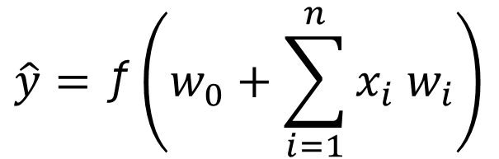
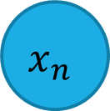
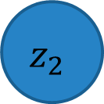

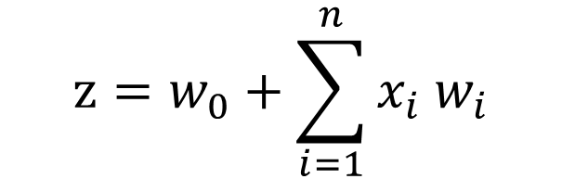

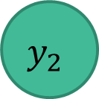



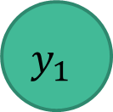




Artificial Neural networks (ANN)
Each output has its own weight for each input
Inputs
Weights
Outputs
$$x_{1}$$
$$w_{1_1}$$
$$w_{1_2}$$
$$z_{1}$$
$$y_{1}=\text{ƒ}\text{(}z_{1}\text{)}$$
$$y_{1}$$
$$w_{2_1}$$
$$z=w_{0}+\sum_{i=1}^{n}{x_{i}{ w}_{i}}$$
$$x_{2}$$
$$w_{2_2}$$
$$w_{n_1}$$
$$z_{2}$$
$$y_{2}=\text{ƒ}\text{(}z_{2}\text{)}$$
$$y_{2}$$
$$x_{n}$$
$$\hat{y}=\text{ƒ}\left(w_{0}+\sum_{i=1}^{n}{x_{i}{ w}_{i}}\right)$$
$$w_{n_2}$$

Slide 40


Slide 41

Poll Everywhere multiple choice poll activity
Activity Title: How many inputs can a perceptron have?
Slide 40
Notes:
Do not modify the notes in this section to avoid tampering with the Poll Everywhere activity.
More info at polleverywhere.com/support
How many inputs can a perceptron have?
https://www.polleverywhere.com/multiple_choice_polls/09i3xP4Yo9cpUiPIg9Cif

Slide 42

Poll Everywhere multiple choice poll activity
Activity Title: How many weights has each input in a perceptron?
Slide 39
Notes:
Do not modify the notes in this section to avoid tampering with the Poll Everywhere activity.
More info at polleverywhere.com/support
How many weights has each input in a perceptron?
https://www.polleverywhere.com/multiple_choice_polls/hA2yJJnyCGDuTmdblGmM4

Slide 43

Poll Everywhere multiple choice poll activity
Activity Title: How many hidden layers can a network have?
Slide 41
Notes:
Do not modify the notes in this section to avoid tampering with the Poll Everywhere activity.
More info at polleverywhere.com/support
How many hidden layers can a network have?
https://www.polleverywhere.com/multiple_choice_polls/z9tSTE3xeQFLikoq4uoRA

Slide 44


Multi-layer neural networks example
Input layer
Hidden layers
Output layer
Dense layer
==
Fully connected layer
Input
Probability of cancer
$$X$$
$$X$$
95%
data
Probability of no cancer
5%

Slide 45
ANNs: How many inputs and outputs do we need?
The number of inputs will depend on our data.
Example 1: Iris dataset
4 inputs
1 output
 | sepal_length | sepal_width | petal_length | petal_width | species
0 | 5.1 | 3.5 | 1.4 | 0.2 | setosa
1 | 4.9 | 3.0 | 1.4 | 0.2 | setosa
2 | 4.7 | 3.2 | 1.3 | 0.2 | setosa
3 | 4.6 | 3.1 | 1.5 | 0.2 | setosa
4 | 5.0 | 3.6 | 1.4 | 0.2 | setosa
… | … | … | … | … | …
50 | 7.0 | 3.2 | 4.7 | 1.4 | versicolor
51 | 6.4 | 3.2 | 4.5 | 1.5 | versicolor
52 | 6.9 | 3.1 | 4.9 | 1.5 | versicolor
53 | 5.5 | 2.3 | 4.0 | 1.3 | versicolor
54 | 6.5 | 2.8 | 4.6 | 1.5 | versicolor
55 | 5.7 | 2.8 | 4.5 | 1.3 | versicolor

Slide 46

ANNs: How many inputs and outputs do we need?
Example 2: Images
1 2 3 4 5 6 7 8 9 10 11 12 13 14 15
1 2 3 4 5 6 7 8 9 10 11 12
→ 15x12 = 180 pixels → 180 input units
Dog/no dog
→ 1 label/class to predict → 1 output (0 or 1)
Next week: Convolutional Neural Networks

Slide 47
How many hidden layers and neurons do we need?
The number of hidden layers, and the number of units depends on the complexity of the problem and there is not strict rule on determining the number of hidden layers.
The more complex the problem, the more layers and units you will need.
Easy problem: classify the iris dataset (4 input variables, 1 class as output)
Complex problem: image recognition (225X255 images, 1000 classes as output)
For reference:
Model | Layers | Parameters
GPT-3 (OpenAI, 2020 paper) | 96 transformer layers | 175 billion

Slide 48

For reference only: activation functions
Non-linear
Non-linear activation functions allow to learn more complex mappings

Slide 49









What can we do with Ann?
Interest prediction
Shopping prediction
Recognition/Classification
Cancer detection
Drug discovery
Student retention
Chatbots
Weather prediction
Do you know more examples?
Stock market prediction

Slide 50





Research

Slide 51
RECAP: Types of machine Learning
Machine learning
Supervised Learning
Unsupervised Learning
Reinforcement Learning
We have both supervised and unsupervised neural networks. We will focus the rest of the lecture on supervised learning.

Slide 52
Next…
How to train neural networks
Main issues during training and how to solve them.
Data: data split, data bias, …
Evaluation

Slide 53
Neural Networks: workflow
Testing
Training
Inference
Data (test)
Data (training)
Data (new)
Validation
Change hyperparameters
Trained model
Your neural network model
Train model
Validation
Trained model
Prediction
Prediction
Data (validation)
Trained model
Prediction
Evaluation

Slide 54
Data SPLIT
Dataset:
Know your data:
Training set
Validation set
Test set
80%
10%
10%
(larger datasets)
60%
20%
20%
(small datasets)
Imbalanced dataset
Balanced dataset
80% data
50% data
50% data
20% data
Cat
Dog
Cat
Dog

Slide 55


Neural network example
Input
Input layer
Multiple hidden layers
Output layer
How do we initialise weights?
$$X$$
$$X$$
How can we find the optimum weights so that the error is minimal?

Slide 56
Training a neural network
Train model
Objective: find the optimum weights that will give the lowest error [loss]
Optimisation (Gradient Descent)
  Randomly initialise weights
  Find how much the weights need to change (by computing the derivatives)
  Update weights by taking a small step [learning rate]
  Repeat until convergence (until there is no improvement) [number of epochs]

Slide 57








Training a neural network: loop
Train model
FORWARD PROPAGATION
$$x_{1}$$
$$z_{1}$$
When do we stop?
$${\hat{y}}_{1}$$
Update weights
After a specific number of iterations (epochs)
$$x_{2}$$
$$z_{2}$$
$${\hat{y}}_{2}$$
$$x_{n}$$
$$z_{n}$$
Find loss (error)
BACKWARD PROPAGATION
Input layer
Hidden layers
Output layer

Slide 58
For REFERENCE only: Loss optimisation
Train model
Identify (train) a set of weights that will give us the minimum error
Loss functions: Cross entropy, Mean Squared Error, Mean Absolute Error.
Needs to be differentiable (the derivative of the function exists for all points).
Binary classification | Multiclass classification | Regression
Loss: Cross Entropy | Loss: Cross Entropy | Loss: Mean Squared Error
Activation: Sigmoid | Activation: Softmax

Slide 59














Backpropagation: Backward propagation of errors
Train model
Compute the gradients (computationally expensive!)
How does a small change on the weights affect the final loss $J(W)$?
Watch: https://www.youtube.com/watch?v=IN2XmBhILt4&list=PLblh5JKOoLUIxGDQs4LFFD--41Vzf-ME1&index=4
$$x_{1}$$
$$w_{1}$$
$$z_{1}$$
$$w_{2}$$
$$\hat{y}$$
$$J(W)$$
How much a change in $w_{2}$will affect the total error (loss) $J(W)$?
The partial derivative of the loss with respect to $w_{2}$
$$\frac{∂J(W)}{∂w_{2}}=\frac{∂J(W)}{∂\hat{y}}∗\frac{∂\hat{y}}{∂w_{2}}$$
How much a change in $w_{1}$will affect the total error (loss) $J(W)$?
$$\frac{∂J(W)}{∂w_{1}}=\frac{∂J\left(W\right)}{∂\hat{y}}∗\frac{∂\hat{y}}{∂z_{1}}∗\frac{∂z_{1}}{∂w_{1}}$$
$$w_{2}$$
$$w_{1}$$

Slide 60
Learning Rate
Train model
How much step we take in the gradient?
Small learning rate
Good learning rate
Large learning rate

Slide 61








Forward propagation and backpropagation
Train model
Input
(flatten)
Input layer
Multiple hidden layers
Output layer
% Cat
$$X$$
$$X$$
% Dog

Slide 62

Inference
Input
(flatten)
Input layer
Multiple hidden layers
Output layer
95% Cat
$$X$$
$$X$$
5% Dog

Slide 63

Inference
Input
(flatten)
Input layer
Multiple hidden layers
Output layer
% Cat
$$X$$
$$X$$
% Dog

Slide 64

Poll Everywhere multiple choice poll activity
Activity Title: What will the NN predict?
Slide 64
Notes:
Do not modify the notes in this section to avoid tampering with the Poll Everywhere activity.
More info at polleverywhere.com/support
What will the NN predict?
https://www.polleverywhere.com/multiple_choice_polls/3gL82lMLIFfjIciYmPNiy?state=opened&flow=Default&onscreen=persist

Slide 65

Softmax and the cow
What should this network answer for a cow?
cat
0.73
dog
0.27
cat
0.55
dog
0.45
softmax(z)ᵢ = e^zᵢ / Σⱼ e^zⱼ the outputs always sum to 1

Slide 66
Training (how long?)
Train model
Some (most) neural networks will not reach a 100% accuracy. How long do we have to train them?
Training set
Accuracy
Validation set
Needs more training
Best accuracy
Overfitting
Epochs

Slide 67

Problems: Learning rate
Evaluate model
If the learning rate is too high, the loss can oscillate or diverge
If the learning rate is too small, the training can get stuck

Slide 68
Problems: overfitting
Evaluate model
Input layer
Multiple hidden layers
Output layer
When the network has ‘memorised’ the training data. Regularisation techniques:
  Dropout: We set some activation to 0 (usually 0.5) during training
  Early stopping: stop training before it overfits the data
Training set accuracy
Overfitting
Accuracy
Validation set accuracy
Epochs

Slide 69

Training
Accuracy
Epochs

Slide 70
How do we know it works?

Slide 71
Our spam detector is tested on 100 emails it has never seen. The accuracy is 99%.
Can we trust it?

Slide 72


Accuracy: how good is the model?
Data
A model says “No spam" every time.
The model never says “spam”.
What is its accuracy?
$$accuracy= \frac{number correct predictions}{total number of emails}$$
$$accuracy= \frac{99}{100}=0.99 (99\%‼)$$
Can we trust it?
■ No spam ■ Spam

Slide 73
Count the mistakes: confusion matrix
Flagged spam
Passed as good
0
caught spam
1
missed spam
Really spam (1)
0
good email flagged
99
good email passed
Really not spam (99)

Slide 74

Count the mistakes: confusion matrix
Flagged spam
Passed as good
6
caught spam
4
missed spam
Really spam (10)
3
good email flagged
87
good email passed
Really not spam (90)
$$accuracy= \frac{(6+87)}{100}=0.93 (93\%)$$
Which one do you prefer?

Slide 75

Final year project: Start with the question, not the dataset
Does the dataset have the answer to your question?

Slide 76

Tensorflow & KERAS
https://www.tensorflow.org/tutorials/keras/classification

Slide 77

PyTorch
https://pytorch.org/tutorials/beginner/basics/buildmodel_tutorial.html

Slide 78
Thank you!

